Slide 1

Database Systems:
Design, Implementation, and Management
Chapter 1
Database Systems

Slide 2
Basics
  A database is a collection of data treated as a unit. The purpose of a database is to store and retrieve related information.
  A Database should reliably manage a large amount of data in a multiuser environment so that many users can concurrently access the same data
  Examples: ORACLE, SQL SERVER, DB2, MS ACCESS, FILEMAKER PRO, VISUAL FOX PRO
Database Systems, 9th Edition

Slide 3
Data vs. Information
Data are raw facts
Information is the result of processing raw data to reveal meaning
Information requires context to reveal meaning
Raw data must be formatted for storage, processing, and presentation
Data are the foundation of information, which is the bedrock of knowledge
Database Systems, 9th Edition

Slide 4
Data vs. Information (cont’d.)
Information is produced by processing data
Information is used to reveal meaning in data
Must be: Accurate, relevant & timely
Information is the key to good decision making
Good decision making is the key to organizational survival
Database Systems, 9th Edition

Slide 5
Why Databases?
Databases solve many of the problems encountered in data management
  Used in almost all modern settings involving data management:
    Business
    Research
    Administration
Database Application Examples:
Inventory, Human Resources, Production, Shipping, Order Processing, Invoicing
Database Systems, 9th Edition

Slide 6
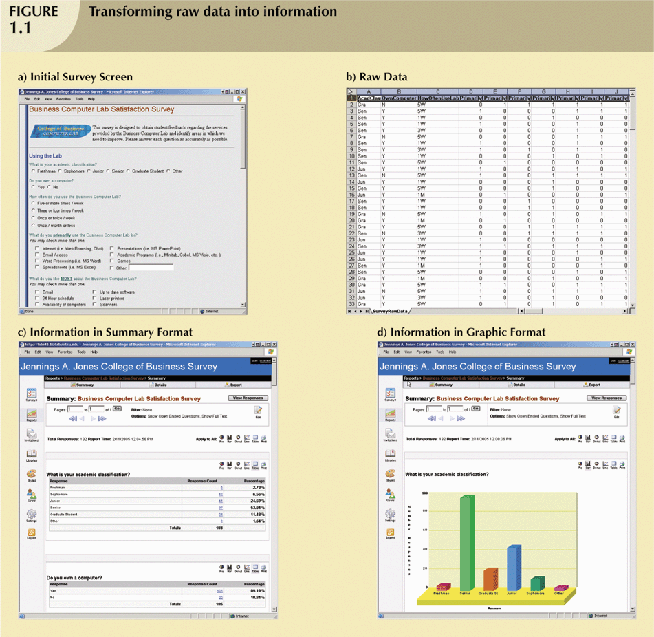
Transforming Raw Data into Information
Database Systems, 9th Edition

Slide 7
Transforming Raw Data into Information (continued)
Database Systems, 9th Edition

Slide 8
Transforming Raw Data into Information (continued)
Database Systems, 9th Edition

Slide 9
Transforming Raw Data into Information (continued)
Database Systems, 9th Edition

Slide 10
Introducing the Database
Database: shared, integrated computer structure that stores a collection of:
  End-user data: raw facts of interest to end user
  Metadata: data about data
    Provides description of data characteristics and relationships in data
    Complements and expands value of data
Database management system (DBMS): collection of programs
  Manages structure and controls access to data
Database Systems, 9th Edition

Slide 11
Role and Advantages of the DBMS
DBMS is the intermediary between the user and the database
  Database structure stored as file collection
  Can only access files through the DBMS
DBMS enables data to be shared
DBMS integrates many users’ views of the data
Database Systems, 9th Edition

Slide 12
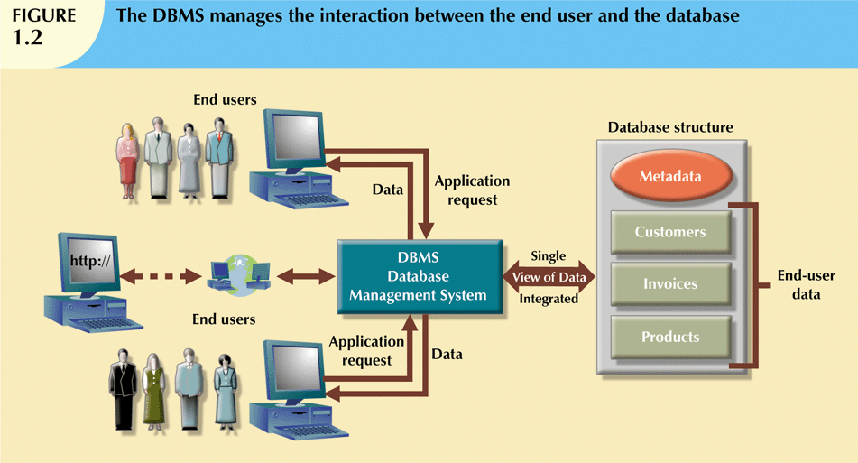
Database Systems, 9th Edition

Slide 13
Role and Advantages of the DBMS (cont’d.)
Advantages of a DBMS:
  Improved data sharing
  Improved data security
  Better data integration
  Minimized data inconsistency
  Improved data access
  Improved decision making
  Increased end-user productivity
Database Systems, 9th Edition

Slide 14
Types of Databases
Databases can be classified according to:
  Number of users
  Database location(s)
  Expected type and extent of use
Single-user database supports only one user at a time
  Desktop database: single-user; runs on PC
Multiuser database supports multiple users at the same time
  Workgroup and enterprise databases
Database Systems, 9th Edition

Slide 15
Types of Databases (continued)
Workgroup:
  Multi-user database that supports a small group of users or a single department
Enterprise:
  Multi-user database that supports a large group of users or an entire organization
Database Systems, 9th Edition

Slide 16
Types of Databases (cont’d.)
Centralized database: data located at a single site
Distributed database: data distributed across several different sites
Operational database: supports a company’s day-to-day operations
  Transactional or production database
Data warehouse: stores data used for tactical or strategic decisions or to store historical data
Database Systems, 9th Edition

Slide 17
Types of Databases (cont'd.)
Unstructured data: exist in their original state
Structured data: result from formatting
Extensible Markup Language (XML): represents data elements in textual format
Database Systems, 9th Edition

Slide 18
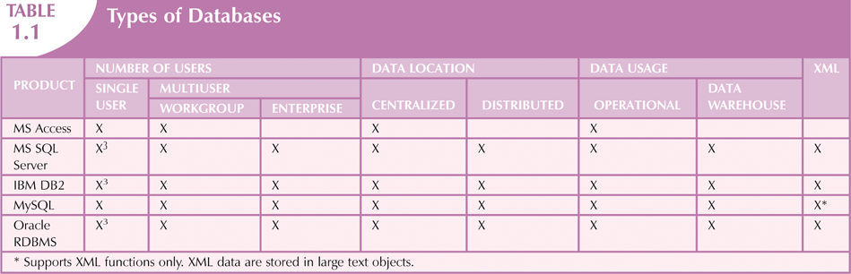
Database Systems, 9th Edition

Slide 19
Why Database Design Is Important?
Database design focuses on design of database structures - Designer must identify database’s expected use
Well-designed database:
  Facilitates effective & efficient data management
  Generates accurate and valuable information
Poorly designed database leads to errors
Database Systems, 9th Edition

Slide 20
Evolution of File System Data Processing -
Pre- computer systems, Manual File systems were made up of collection of folders, each tagged and kept in cabinet or ledger (large books)
Read text section 1.5
Database Systems, 9th Edition

Slide 21
Evolution of File System Data Processing (cont'd.)
Contents of each file folder are logically related
Manual systems were Cumbersome for large collections
Did not support ad-hoc queries easily
With the introduction of Computer technology:
  Data processing (DP) specialist converted computer file structure from manual system
    Wrote software that managed the data
    Designed the application programs
Database Systems, 9th Edition

Slide 22
Evolution of File System Data Processing (cont'd.)
Initially, computer file systems resembled manual systems
As number of files increased, file systems evolved
  Each file used its own application program to store, retrieve, and modify data
  Each file was owned by individual or department that commissioned its creation
Database Systems, 9th Edition

Slide 23
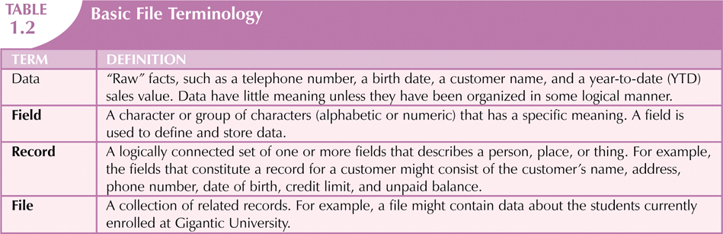
Database Systems, 9th Edition

Slide 24
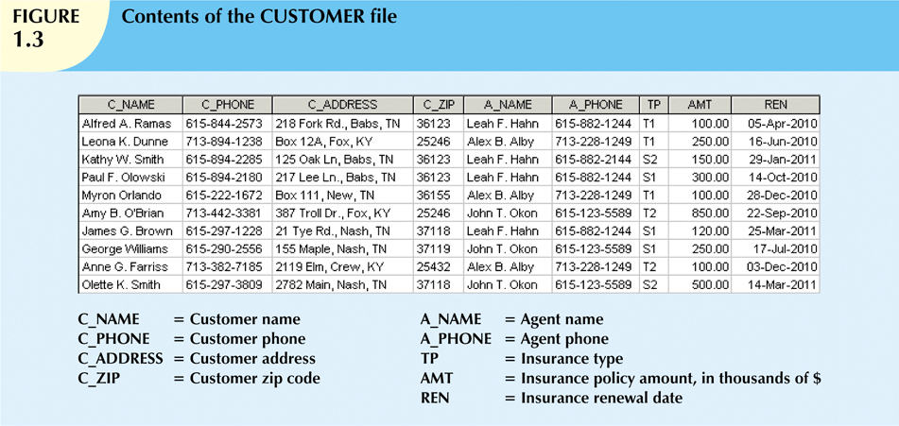
Database Systems, 9th Edition

Slide 25
Historical Roots: Files and File Systems (continued)
As the requirement for additional departmental systems increased, more file systems evolved
Each file used its own application programs
Each file was owned by individual or department who commissioned its creation
Database Systems, 9th Edition

Slide 26
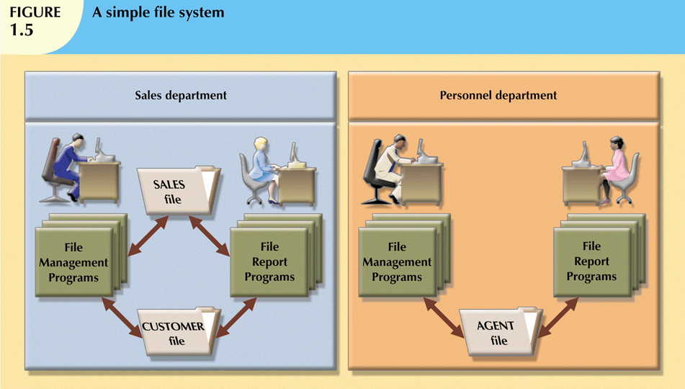
Separate Departments had file systems developed for their own use - inefficient
Database Systems, 9th Edition

Slide 27
Problems with File System Data Management
Every task requires extensive programming in a third-generation language (3GL)
  Programmer must specify task and how it must be done
Modern databases use fourth-generation languages (4GL)
  Allow users to specify what must be done without specifying how it is to be done
Database Systems, 9th Edition

Slide 28
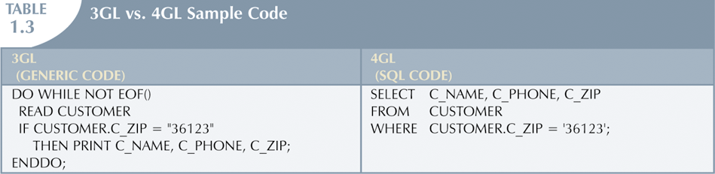
3 GL vs 4GL
3GL What to do and how to do it
4GL – just what to do
Database Systems, 9th Edition

Slide 29
Problems with File System Data Processing
  Requires extensive programming
  Cannot perform ad hoc queries
  System administration is complex and difficult
  Difficult to make changes to existing structures
  Security features are likely to be inadequate
Database Systems, 9th Edition

Slide 30
Structural and Data Dependence – some definitions
Structural dependence: access to a file is dependent on its own structure
Structural independence: can change file structure without affecting data access
Data dependence: data access changes when data storage characteristics change
Data independence: data storage characteristics do not affect data access
Please refer to Data Structures document in content link for examples
Exam!
Database Systems, 9th Edition

Slide 31
Structural and Data Dependence (cont'd.)
Logical data format: how human views the data
Physical data format: how computers work with data
With data dependence, each program must specify:
  The opening of each file to be accessed and its type
  Record specification (field layout sequence)
  Field definitions (field type for each field)
Database systems support Data Independence - so no need to do the above.
Exam!
Database Systems, 9th Edition

Slide 32
Data Redundancy
File system structure makes it difficult to combine data from multiple sources
This type of Data Organization promotes storage of same data in different locations
Data stored in different locations is unlikely to be updated consistently
This leads to Data redundancy:
- same data stored unnecessarily in different places
Exam!
Database Systems, 9th Edition

Slide 33
Data Redundancy (cont'd.)
Data inconsistency is the result:
  different and conflicting versions of same data occur in different places
Caused by Data anomalies: changes to the data are not consistently reflected in the all the places it occurs.
Exam!
Database Systems, 9th Edition

Slide 34
Data Redundancy (continued)
Types of data anomalies:
Update anomalies
  Occur when changes must be made to existing records in different places - could end up with different values
Insertion anomalies
  Occur when entering new records – different values or not inserted in all affected files
Deletion anomalies
  Occur when deleting records – not all occurrences deleted
Exam!
Database Systems, 9th Edition

Slide 35
Database Systems
Problems inherent in file systems make using a database system desirable
File system
  Many separate and unrelated files
Database
  Logically related data stored in a single logical data repository
Database Systems, 9th Edition

Slide 36
Data-Modeling Skills
Most users lack the skill to properly design databases
Data-modeling skills are vital in the data design process
Good data modeling facilitates communication between the designer, user, and the developer
Database Systems, 9th Edition

Slide 37
Database Systems
Database system consists of logically related data stored in a single logical data repository
  Data may be physically distributed among multiple storage facilities
  The DBMS stores data structures, relationships between structures, and access paths
  The DBMS eliminates most of file system’s problems
Database Systems, 9th Edition

Slide 38
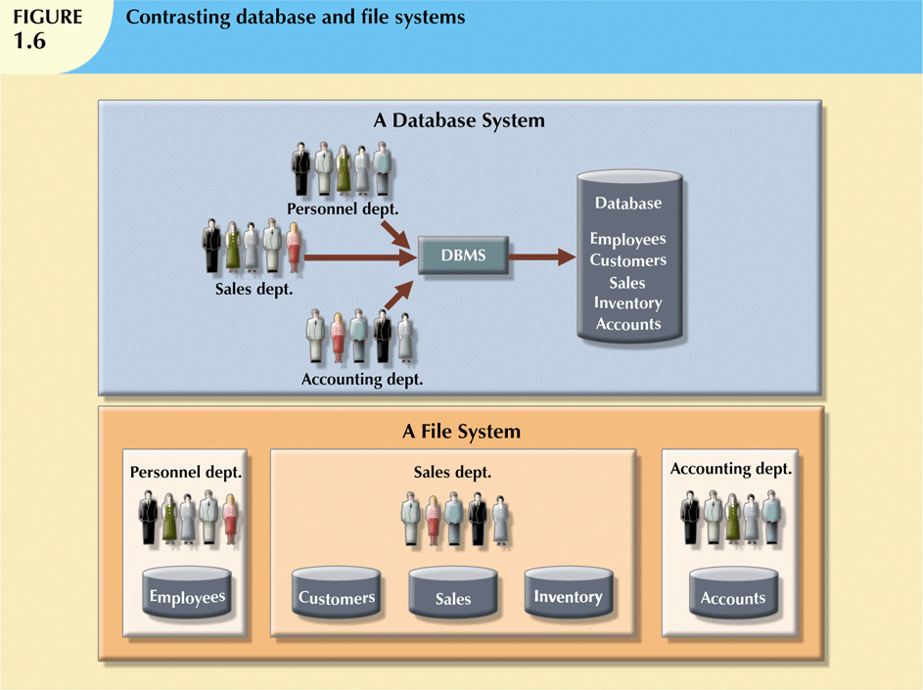
Many Separate File Systems vs One Database System
Database Systems, 9th Edition

Slide 39
The Database System Environment
Five major parts of a database system:
  Hardware
  Software (OS, DBMS, Application and Utility SW)
  People
  Procedures
  Data
Exam!
Database Systems, 9th Edition

Slide 40
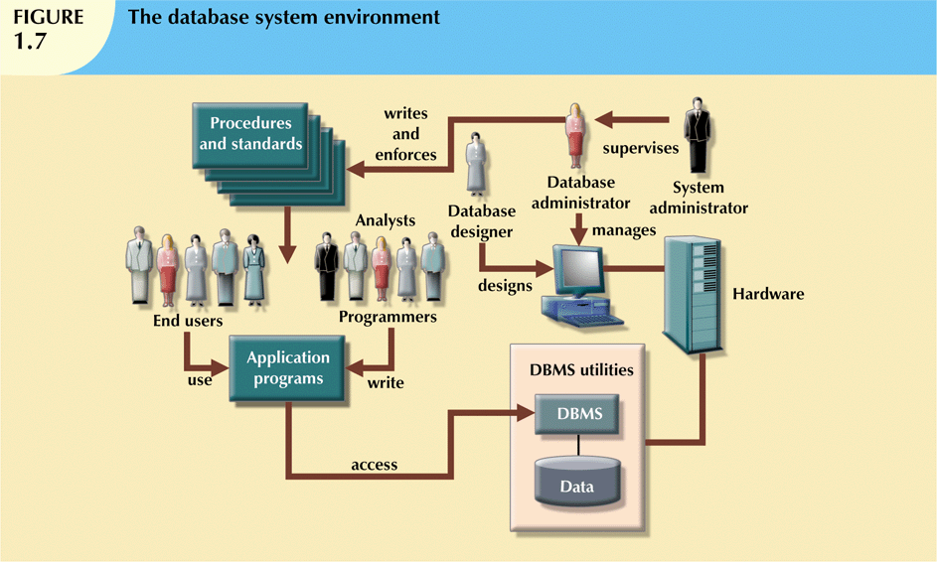
Database Systems, 9th Edition

Slide 41
The Database System Environment (cont'd.)
Hardware: all the system’s physical devices
Software: three types of software required:
  Operating system software
  DBMS software
  Application programs and utility software
Exam!
Database Systems, 9th Edition

Slide 42
The Database System Environment (cont'd.)
People: all users of the database system
  System and database administrators
  Database designers
  Systems analysts and programmers
  End users
Procedures: instructions and rules that govern the design and use of the database system
Data: the collection of facts stored in the database
Exam!
Database Systems, 9th Edition

Slide 43
DBMS Functions
Most DBMS functions are transparent to end users
Data dictionary management
  DBMS stores definitions of data elements and relationships (metadata) in a data dictionary
  Changes automatically recorded in the dictionary
  DBMS provides data abstraction and removes structural and data dependency
Database Systems, 9th Edition

Slide 44
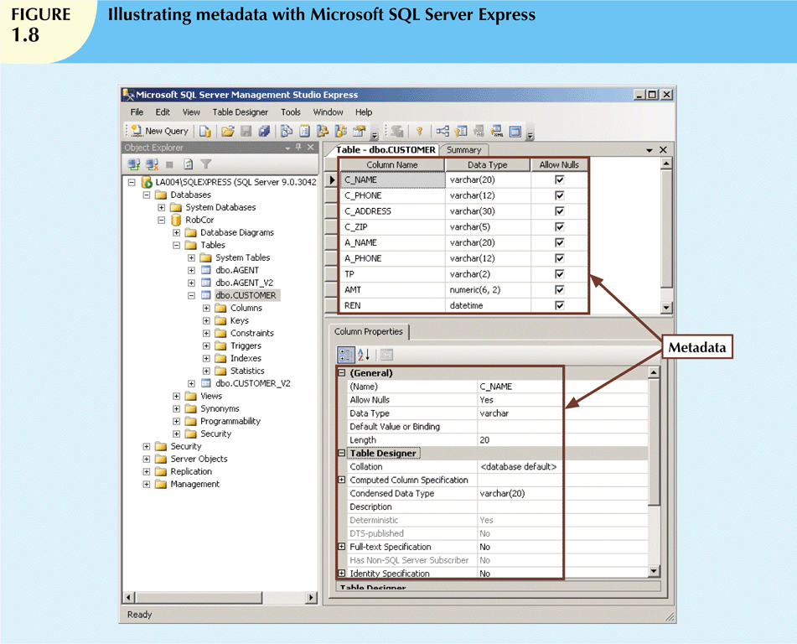
Database Systems, 9th Edition

Slide 45
DBMS Functions (cont'd.)
Data storage management
  DBMS creates and manages complex data storage structures
  DBMS stores related data entry forms, screen definitions, report definitions, etc.
  DBMS carries automatic Performance tuning: activities that make the database perform more efficiently
  DBMS stores the database in multiple physical data files
Database Systems, 9th Edition

Slide 46
DBMS Functions (cont'd.)
Data transformation and presentation
  DBMS transforms data entered to conform to required data structures
  DBMS transforms physically retrieved data to conform to user’s logical expectations
Security management
  DBMS creates a security system that enforces user security and data privacy
  Security rules determine which users can access the database, which items can be accessed, etc.
Database Systems, 9th Edition

Slide 47
DBMS Functions (cont'd.)
Multiuser access control
  DBMS uses sophisticated algorithms to ensure concurrent access does not affect integrity
Backup and recovery management
  DBMS provides backup and data recovery to ensure data safety and integrity
  Recovery management deals with recovery of database after a failure
    Critical to preserving database’s integrity
Database Systems, 9th Edition

Slide 48
DBMS Functions (cont'd.)
Data integrity management
  DBMS promotes and enforces integrity rules
    Minimizes redundancy
    Maximizes consistency
  Data relationships stored in data dictionary used to enforce data integrity
  (Integrity is especially important in transaction-oriented database systems)
Database Systems, 9th Edition

Slide 49
DBMS Functions (cont'd.)
Database access languages and application programming interfaces
  DBMS provides access through a query language
  Query language is a nonprocedural language
  Structured Query Language (SQL) is the de facto query language
    Standard supported by majority of DBMS vendors
Database Systems, 9th Edition

Slide 50
DBMS Functions (cont'd.)
Database communication interfaces
  Current DBMSs accept end-user requests via multiple different network environments
  Communications accomplished in several ways:
    End users generate answers to queries by filling in screen forms through Web browser
    DBMS automatically publishes predefined reports on a Web site
    DBMS connects to third-party systems to distribute information via e-mail
Database Systems, 9th Edition

Slide 51
Disadvantages of database systems:
  Increased costs
  Management complexity
  Maintaining currency (latest supported version)
  Vendor dependence
  Frequent upgrade/replacement cycles (and inherent cost)
Exam!
Database Systems, 9th Edition

Slide 52
Summary (please read through this section & refer to chapter 1 for more details)
Data are raw facts
Information is the result of processing data to reveal its meaning
Accurate, relevant, and timely information is the key to good decision making
Data are usually stored in a database
DBMS implements a database and manages its contents
Database Systems, 9th Edition

Slide 53
Summary (cont'd.)
Metadata is data about data
Database design defines the database structure
  Well-designed database facilitates data management and generates valuable information
  Poorly designed database leads to bad decision making and organizational failure
Databases evolved from manual and computerized file systems
Database Systems, 9th Edition

Slide 54
Summary (cont'd.)
In a file system, data stored in independent files
  Each requires its own management program
Some limitations of file system data management:
  Requires extensive programming
  System administration is complex and difficult
  Changing existing structures is difficult
  Security features are likely inadequate
  Independent files tend to contain redundant data
    Structural and data dependency problems
Database Systems, 9th Edition

Slide 55
Summary (cont'd.)
Database management systems were developed to address file system’s inherent weaknesses
DBMS present database to end user as single repository
  Promotes data sharing
  Eliminates islands of information
DBMS enforces data integrity, eliminates redundancy, and promotes security
Database Systems, 9th Edition

Slide 56
Week 1 - Class Exercise
Get into your groups (see Group slide)
Short introductions at this stage (additional time for more introductions after the class exercise)
Work on Problems 9 & 10, Chapter 1
Take a few minutes to study/work on individually
Then discuss with group members
I will discuss with you after
Database Systems, 9th Edition

Slide 57
Group Exercise 1
(D2L: Content>Week 1>On Line Discussion Questions)
On-Line - Discussion Questions
Work on the answers with your group. You may wish to assign several questions per person and then discuss with the group until you agree on the answers.
Once you have determined your answers, post it in the Mod 1 Group Answers section of the Discussions area.
(You will need your Text Books)
Database Systems, 9th Edition

Slide 58
Your Tasks
For Now:
In your groups, get to know each other; exchange email addresses / contact details) – see group slide
Look at the Review Questions and Problems which have been set.
Decide who is going to do which questions, in each group.
Appoint a coordinator for review and final posting
Start the work now if there is time.
Away from the Classroom:
Read All of Chapter 1
Discuss On Line
Post Final Answers
Go to Cengagebrain.com and access material
Read next week’s slides (posted at least 2 days before class) and read Chapters 2&3 in preparation for next week’s class

